Slide 1


Artificial Neural Networks
13
PART III · SUPERVISED LEARNING ALGORITHMS
CHAPTER 13 · WEEK 11
Machine Learning — From Hypotheses to Decisions
LECTURER
Dr. Mustafa Hameed
THE ISLAMIA UNIVERSITY OF BAHAWALPUR
Bahawalpur, Pakistan
Department of Information Technology · BSIT · Fall 2026
Notes:
Chapter 13: Artificial Neural Networks. Part 3 — Supervised Learning Algorithms. Week 11: Neural networks; the project brief. Handout pages 98–105.

Slide 2

Where this chapter sits
THE COURSE
PART I
PART II
PART III
PART IV
PART V
PART VI
1
2
3
4
5
6
7
8
9
10
11
12
13
14
15
16
17
18
19
20
21
22
Artificial Neural Networks
BUILDS ON
USED LATER IN
Ch 2 Mathematics for Machine Learning
Ch 16 Dimensionality Reduction and Self-Organizing Maps
Ch 6 Logistic Regression
Ch 20 Reinforcement Learning
Ch 7 Overfitting, Bias–Variance and Regularisation
Ch 21 Responsible and Ethical Machine Learning
Machine Learning · Chapter 13 · Artificial Neural Networks
Handout p. 98 2
Notes:
Place the chapter. Before you start: Chapter 2 (the chain rule, gradient descent), Chapter 6 (the sigmoid, the softmax, cross-entropy) and Chapter 7 (overfitting, regularisation).

Slide 3

What you will be able to do
LEARNING OUTCOMES
By the end of this chapter you will be able to:
1
Compute the output of a perceptron and train one with the perceptron rule.
2
Explain linear separability and why a single perceptron cannot learn XOR.
3
Derive the delta rule as gradient descent on squared error.
4
Perform one forward and backward pass of backpropagation through a small multilayer network by hand.
5
Choose activation functions and apply early stopping, weight decay and dropout against overfitting.
Machine Learning · Chapter 13 · Artificial Neural Networks
Handout p. 98 3
Notes:
Read these out: they are the chapter's contract with the room. Each click adds one.

Slide 4

Vocabulary for this chapter
KEY TERMS
artificial neuron
perceptron
threshold unit
perceptron training rule
linear separability
XOR
delta rule
sigmoid unit
multilayer perceptron
hidden layer
forward pass
backpropagation
epoch
activation function
ReLU
early stopping
weight decay
dropout
Each term is defined where it first matters — not here.
Machine Learning · Chapter 13 · Artificial Neural Networks
Handout p. 98 4
Notes:
Do not define these now; they arrive one at a time. This slide is for the students' notes. Terms: artificial neuron; perceptron; threshold unit; perceptron training rule; linear separability; XOR; delta rule; sigmoid unit; multilayer perceptron; hidden layer; forward pass; backpropagation; epoch; activation function; ReLU; early stopping; weight decay; dropout.

Slide 5

In this chapter
IN THIS CHAPTER
13.1
From Neurons to Units
p. 98 ›
13.2
The Perceptron
p. 99 ›
13.3
Linear Separability and XOR
p. 100 ›
13.4
Gradient Descent and the Delta Rule
p. 100 ›
13.5
Multilayer Networks and Backpropagation
p. 100 ›
13.6
Activation Functions and Outputs
p. 102 ›
13.7
Training Well: Overfitting and Its Cures
p. 102 ›
Machine Learning · Chapter 13 · Artificial Neural Networks
Handout pp. 98–105 5
Notes:
The route through the chapter. Each row is a link: click it to jump to that section in the slide show.

Slide 6

From Neurons to Units
KEY IDEA
A biological neuron receives signals from thousands of others, and fires if their combined stimulation exceeds a threshold. Learning, roughly, changes the strength of the connections. An artificial neural network keeps just that much of the biology: many simple units, each computing a weighted sum of its inputs and passing it through a simple function, connected so that the outputs of some are the inputs of others. Everything the network knows is in the connection weights, and learning means adjusting them.
Networks are the right tool when the input is high-dimensional and raw — pixels, audio samples, sensor streams — when the target function is complex and unknown, when some noise is acceptable, when long training times are acceptable, and when nobody needs to read the learned function. Mitchell’s examples were steering a car from camera images and recognising faces; today’s are the whole of deep learning.
Machine Learning · Chapter 13 · Artificial Neural Networks
§13.1 · Handout p. 98 6
Notes:
Say this in your own words first; the slide is the handout's wording.

Slide 7
The Perceptron
SECTION 2 OF 7
13.2
13.1 From Neurons to Units
13.2 The Perceptron
13.3 Linear Separability and XOR
13.4 Gradient Descent and the Delta Rule
13.5 Multilayer Networks and Backpropagation
13.6 Activation Functions and Outputs
13.7 Training Well: Overfitting and Its Cures
Machine Learning · Chapter 13
Handout §13.2 7
Notes:
Pause. Name the question this section answers.

Slide 8

Perceptron
DEFINITION
A perceptron computes a weighted sum of its inputs and thresholds it:
With a constant input x₀ = 1 the bias w₀ is just another weight, and the unit computes step(w·x). Its decision boundary is the hyperplane w·x = 0 — the same family as logistic regression and the linear SVM.
Machine Learning · Chapter 13 · Artificial Neural Networks
§13.2 · Handout p. 99 8
Notes:
Read the box aloud, then ask for an example from the room before moving on.

Slide 9
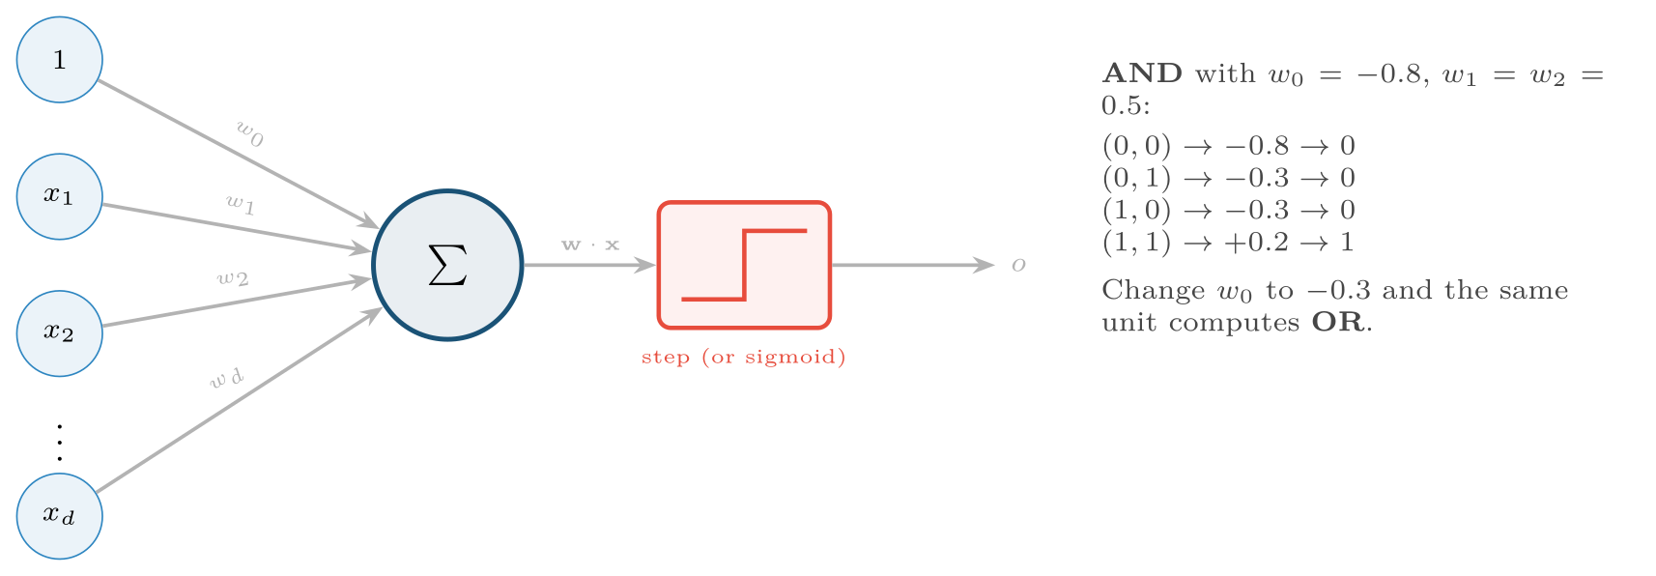
A perceptron: a weighted sum of the inputs, then a threshold
FIGURE 13.1
The bias is a weight on a constant input of 1. With the weights shown on the right it computes logical AND.
Machine Learning · Chapter 13 · Artificial Neural Networks
§13.2 · Handout p. 99 9
Notes:
Figure 13.1 (handout p. 99): A perceptron: a weighted sum of the inputs, then a threshold. The bias is a weight on a constant input of 1. With the weights shown on the right it computes logical AND.

Slide 10
The Perceptron Training Rule
DEFINITION
Start from small (or zero) weights. For each training example with target t and current output o, update every weight:
Correct outputs change nothing; a missed positive pushes the weights towards the input, a false positive pushes them away. If the training examples are linearly separable — some hyperplane separates the classes perfectly — this procedure is guaranteed to find one in a finite number of steps, for any sufficiently small learning rate η.
Machine Learning · Chapter 13 · Artificial Neural Networks
§13.2 · Handout p. 99 10
Notes:
Read the box aloud, then ask for an example from the room before moving on.

Slide 11

Training a Perceptron to Compute AND
WORKED EXAMPLE
Inputs with bias x₀ = 1; weights (w₀, w₁, w₂) start at (0, 0, 0); η = 0.5. The output is 1 only if w·x > 0.
Epoch 1. (0,0), (0,1), (1,0): net = 0, output 0, target 0 — no change. (1,1): net 0, output 0, target 1 — update by 0.5 × (1 − 0) × (1, 1, 1): w = (0.5, 0.5, 0.5).
Epoch 2. (0,0): net 0.5, output 1, target 0 — subtract 0.5 × (1,0,0): w = (0, 0.5, 0.5). (0,1): net 0.5, output 1 — subtract 0.5 × (1,0,1): w = (−0.5, 0.5, 0). (1,0): net 0, correct. (1,1): net 0, output 0 — add 0.5 × (1,1,1): w = (0, 1, 0.5).
Epochs 3–5 continue the same way, and at the end of epoch 5 the weights are w = (−1, 1, 0.5). Check: (0,0) → −1, (0,1) → −0.5, (1,0) → 0, all output 0; (1,1) → +0.5, output 1. Epoch 6 makes no changes: converged. (Trace epochs 3 to 5 yourself: it is standard examination practice.)
Machine Learning · Chapter 13 · Artificial Neural Networks
§13.2 · Handout p. 99 11
Notes:
Each click adds one step of the working. Ask for the next number before you reveal it.

Slide 12
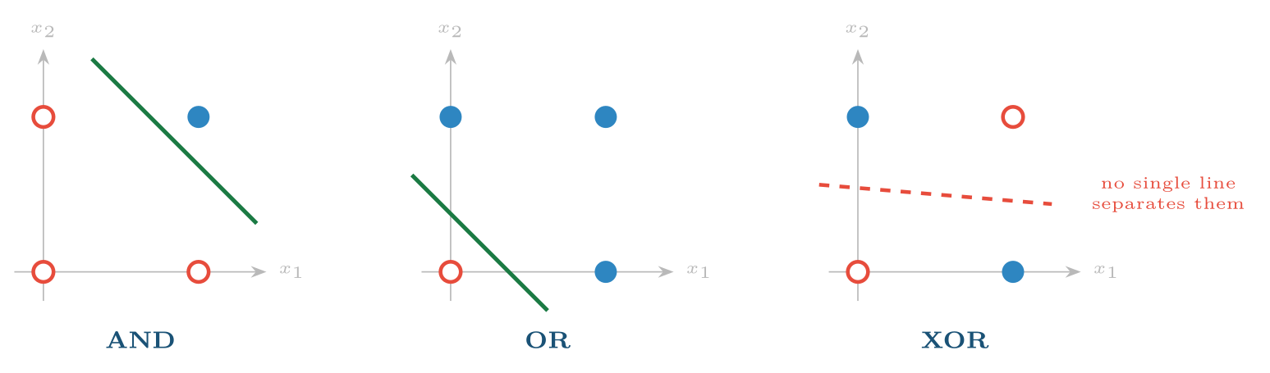
AND and OR are linearly separable; XOR is not
FIGURE 13.2
A second layer of units, each drawing its own line, is needed to represent it.
Machine Learning · Chapter 13 · Artificial Neural Networks
§13.3 · Handout p. 100 12
Notes:
A single perceptron draws one straight line. AND and OR can be separated by a line; XOR — true when exactly one input is true — cannot: its two positive points (0,1) and (1,0) sit on one diagonal and its two negatives on the other. No perceptron, however trained, can represent XOR. Minsky and Papert’s 1969 book made this point so forcefully that neural network research stalled for over a decade.
Figure 13.2 (handout p. 100): AND and OR are linearly separable; XOR is not. A second layer of units, each drawing its own line, is needed to represent it.

Slide 13
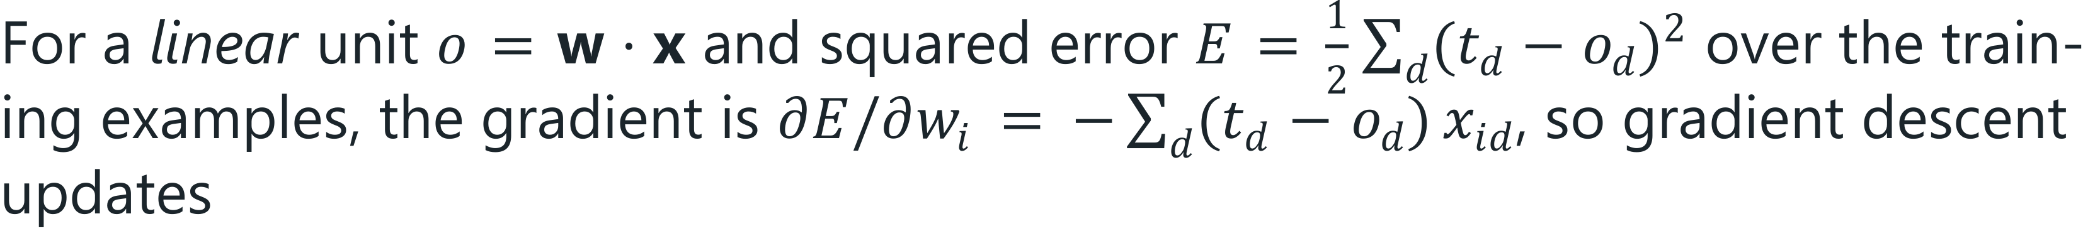
The Delta Rule
DEFINITION
the delta rule (or LMS rule). It looks like the perceptron rule, but it is gradient descent: it converges towards the minimum-error weights even when the data is not separable, which the perceptron rule does not. It is exactly the gradient descent for linear regression of Chapter 5.
Machine Learning · Chapter 13 · Artificial Neural Networks
§13.4 · Handout p. 100 13
Notes:
The cure is a second layer. XOR is “OR but not AND”: one hidden unit computes OR, another computes NAND (not-AND), and an output unit computes AND of the two. Each unit draws one line; together they carve out the diagonal. This is why networks have hidden layers — and the only problem is how to train them, since the perceptron rule needs a target for every unit and the hidden units have none. The perceptron rule cannot be extended to hidden units because the step function has no useful derivative. The fix is to replace hard thresholds with smooth units and train by gradient descent on an error measure.

Slide 14
Multilayer Networks and Backpropagation
SECTION 5 OF 7
13.5
13.1 From Neurons to Units
13.2 The Perceptron
13.3 Linear Separability and XOR
13.4 Gradient Descent and the Delta Rule
13.5 Multilayer Networks and Backpropagation
13.6 Activation Functions and Outputs
13.7 Training Well: Overfitting and Its Cures
Machine Learning · Chapter 13
Handout §13.5 14
Notes:
Pause. Name the question this section answers.

Slide 15
Multilayer Perceptron
DEFINITION
A multilayer perceptron (MLP) arranges sigmoid (or other smooth) units in layers: an input layer, one or more hidden layers, and an output layer. Each unit takes the outputs of the previous layer, forms a weighted sum and applies its activation. A network with one hidden layer of enough units can approximate any continuous function to any accuracy; two hidden layers, any function at all.
Machine Learning · Chapter 13 · Artificial Neural Networks
§13.5 · Handout p. 100 15
Notes:
For a sigmoid unit, o = σ(w·x), the chain rule adds one factor, the derivative of the sigmoid, which has the convenient form σ′(z) = σ(z) (1 − σ(z)) = o(1 − o).

Slide 16
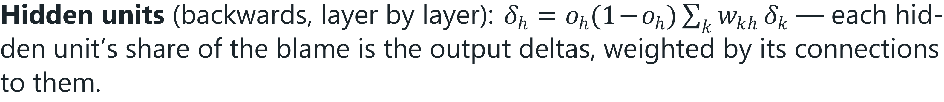
Backpropagation (for sigmoid units and squared error)
DEFINITION
For each training example:
1. Forward pass: compute every unit’s output o, layer by layer.
2. Output units: δ_{k} = o_{k}(1 − o_{k})(t_{k} − o_{k}).
3.
4. Update every weight w_{ji} from unit i to unit j: w_{ji} ← w_{ji} + η δ_{j} x_{ji}, where x_{ji} is the input arriving along that connection.
One sweep through the whole training set is an epoch.
Machine Learning · Chapter 13 · Artificial Neural Networks
§13.5 · Handout p. 100 16
Notes:
Read the box aloud, then ask for an example from the room before moving on.

Slide 17
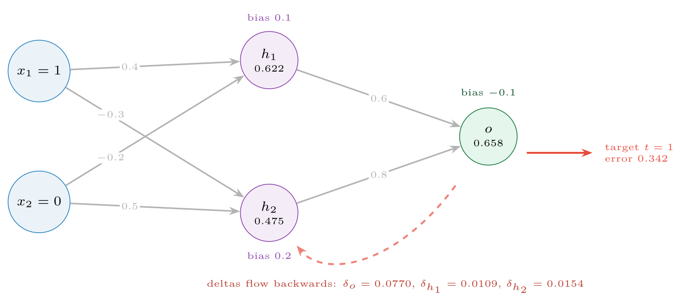
Multilayer Networks and Backpropagation
FIGURE 13.3
The network of the worked example, with the unit outputs of the forward pass written in each unit. Errors computed at the output are passed backwards along the same connections to assign blame to the hidden units.
Machine Learning · Chapter 13 · Artificial Neural Networks
§13.5 · Handout p. 100 17
Notes:
Figure 13.3 (handout p. 101): The network of the worked example, with the unit outputs of the forward pass written in each unit. Errors computed at the output are passed backwards along the same connections to assign blame to the hidden units.

Slide 18
One Step of Backpropagation
WORKED EXAMPLE
The 2–2–1 network of Figure 13.3, all sigmoid units, input (1, 0), target t = 1, learning rate η = 0.5.
Forward.
• h₁: net = 0.1 + 0.4(1) − 0.2(0) = 0.5, output σ(0.5) = 0.6225.
• h₂: net = 0.2 − 0.3(1) + 0.5(0) = −0.1, output σ(−0.1) = 0.4750.
• o: net = −0.1 + 0.6(0.6225) + 0.8(0.4750) = 0.6535, output 0.6578. Error t − o = 0.3422.
Backward.
• δ_{o} = 0.6578 × (1 − 0.6578) × 0.3422 = 0.0770.
• δ_{h1} = 0.6225 × 0.3775 × (0.6 × 0.0770) = 0.0109.
• δ_{h2} = 0.4750 × 0.5250 × (0.8 × 0.0770) = 0.0154.
Machine Learning · Chapter 13 · Artificial Neural Networks
§13.5 · Handout p. 100 18
Notes:
Each click adds one step of the working. Ask for the next number before you reveal it.

Slide 19
One Step of Backpropagation (continued)
WORKED EXAMPLE
Update (Δ w = η δ x).
• Output weights: from h₁: 0.6 + 0.5(0.0770)(0.6225) = 0.6240; from h₂: 0.8 + 0.5(0.0770)(0.4750) = 0.8183; bias: −0.1 + 0.5(0.0770) = −0.0615.
• h₁: weight from x₁ 0.4 → 0.4054, bias 0.1 → 0.1054; from x₂ unchanged, because x₂ = 0.
• h₂: weight from x₁ −0.3 → −0.2923, bias 0.2 → 0.2077.
Check. A new forward pass gives o = 0.6727: closer to 1. The squared error 1/2(t − o)² falls from 0.0586 to 0.0536. Thousands of such small steps are what training a network means.
Machine Learning · Chapter 13 · Artificial Neural Networks
§13.5 · Handout p. 100 19
Notes:
Each click adds one step of the working. Ask for the next number before you reveal it.

Slide 20
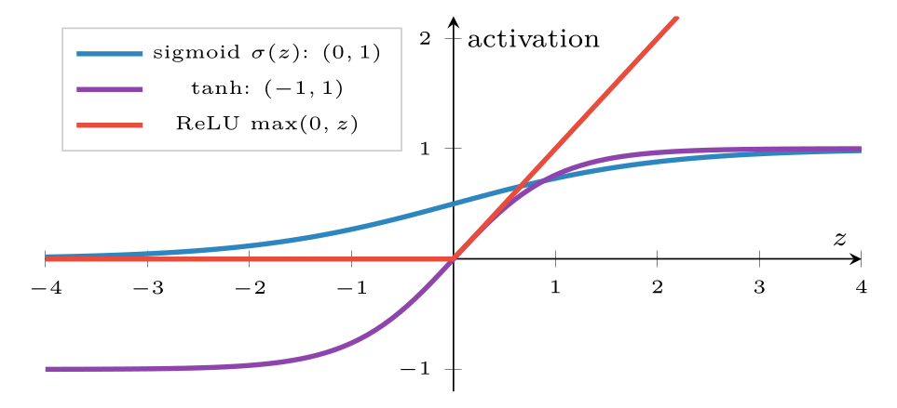
Three activation functions
FIGURE 13.4
The sigmoid and tanh flatten out for large |z|, where their gradients vanish; ReLU does not saturate for positive inputs, which is why it trains deep networks faster.
Machine Learning · Chapter 13 · Artificial Neural Networks
§13.6 · Handout p. 102 20
Notes:
Figure 13.4 (handout p. 102): Three activation functions. The sigmoid and tanh flatten out for large |z|, where their gradients vanish; ReLU does not saturate for positive inputs, which is why it trains deep networks faster.

Slide 21
Training Well: Overfitting and Its Cures
SECTION 7 OF 7
13.7
13.1 From Neurons to Units
13.2 The Perceptron
13.3 Linear Separability and XOR
13.4 Gradient Descent and the Delta Rule
13.5 Multilayer Networks and Backpropagation
13.6 Activation Functions and Outputs
13.7 Training Well: Overfitting and Its Cures
Machine Learning · Chapter 13
Handout §13.7 21
Notes:
Pause. Name the question this section answers.

Slide 22
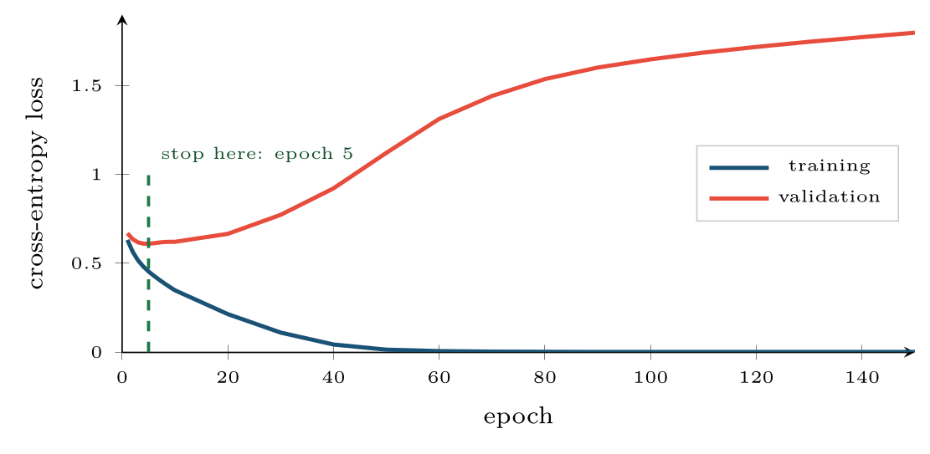
Training and validation loss of a two-hidden-layer network on data with 20% label noise
FIGURE 13.5
Training loss goes to zero; validation loss is lowest after five epochs and rises thereafter. Early stopping keeps the epoch-5 weights.
Machine Learning · Chapter 13 · Artificial Neural Networks
§13.7 · Handout p. 102 22
Notes:
Mitchell’s networks use sigmoids throughout. Modern practice differs in two ways. Hidden layers use ReLU, max(0, z): its gradient is 1 for any positive input, so it does not shrink the error signal the way a saturated sigmoid does (the vanishing gradient that made deep sigmoid networks hard to train). And the output layer matches the task: a single sigmoid with cross-entropy for two classes (exactly logistic regression, Chapter 6), a softmax with cross-entropy for several, a linear unit with squared error for regression. A network with enough hidden units can memorise any training set, and it will if allowed to. Figure 13.5 shows the typical course: training error falls steadily, validation error falls for a while and then rises as the network begins fitting the noise.
Figure 13.5 (handout p. 102): Training and validation loss of a two-hidden-layer network on data with 20% label noise. Training loss goes to zero; validation loss is lowest after five epochs and rises thereafter. Early stopping keeps the epoch-5 weights.

Slide 23

Training Well: Overfitting and Its Cures
AT A GLANCE
Technique | What it does | Setting
Early stopping | Keep the weights from the epoch with the lowest validation error | Needs a validation set; patience of a few epochs
Weight decay (L2) | Add λΣ w² to the loss — ridge regression for networks (Chapter 7) | alpha in scikit-learn; tune by CV
Dropout | During training, switch off each hidden unit at random with probability p, so no unit can rely on another | p ≈ 0.2–0.5; standard in deep learning frameworks
Fewer units | A smaller network has less capacity to memorise | Tune the width by CV
More data, augmented | Real or synthetic variations of the training examples | Flips, crops and noise for images and signals
Machine Learning · Chapter 13 · Artificial Neural Networks
§13.7 · Handout p. 102 23
Notes:
Do not read the table row by row: pick the row the room is most likely to get wrong and ask why.

Slide 24

What the Hidden Units Learn, and What Comes Next
CONCEPT
Backpropagation lets the hidden layer invent its own features. Mitchell’s famous demonstration trains an 8–3–8 network to copy an 8-bit input to its output through only 3 hidden units; the hidden units discover a 3-bit binary code for the eight inputs, a representation nobody programmed. Deep learning is this idea scaled up: many layers, each building features from the one below, with architectures designed for the data — convolutional networks for images, recurrent networks and transformers for sequences. Those architectures are the subject of the Deep Learning course; this chapter is their foundation.
Machine Learning · Chapter 13 · Artificial Neural Networks
§13.7 · Handout p. 102 24
Notes:
Read the box aloud, then ask for an example from the room before moving on.

Slide 25

Common pitfalls
COMMON PITFALLS
✕
Not scaling inputs. Unscaled inputs saturate sigmoid units and make gradient descent crawl.
✕
Initialising all weights to zero. Every hidden unit then computes the same thing and receives the same update forever; initialise randomly.
✕
Training until the training error is zero. Watch the validation error and stop when it turns.
✕
Assuming a network beats a linear model. On small tabular data it often does not; in this chapter’s lab it gains less than one point.
✕
Judging from one run. Random initialisation makes results vary; repeat with several seeds.
Machine Learning · Chapter 13 · Artificial Neural Networks
§13.7 · Handout p. 102 25
Notes:
For each pitfall, ask who has seen it happen. One real story beats five bullets.

Slide 26





Four lenses: Neural Networks
FOUR LENSES
LEARNING ANALYTICS
PROJECT MANAGEMENT
Clickstream sequences from a learning platform — which video, which quiz, how long — are raw, high-dimensional input where networks can find patterns hand-built features miss.
Tabular project data is small and structured, the setting where networks have the least advantage over trees and linear models.
INTERNET OF THINGS
CYBERSECURITY
Networks trained on raw vibration or audio windows detect faults that summary statistics miss, and small networks can be compressed to run on microcontrollers.
Networks classify malware from raw bytes and traffic from packet sequences.
Machine Learning · Chapter 13 · Artificial Neural Networks
Handout p. 105 26
Notes:
The same method, four domains. Each of the next four slides opens one lens in full.

Slide 27

Learning Analytics: Neural Networks
FOUR LENSES
LEARNING ANALYTICS
Project Management
Clickstream sequences from a learning platform — which video, which quiz, how long — are raw, high-dimensional input where networks can find patterns hand-built features miss. They need thousands of students, not hundreds; with one course’s data, the regularised linear model usually wins.
Internet of Things
Cybersecurity
Machine Learning · Chapter 13 · Artificial Neural Networks
Handout p. 105 27
Notes:
Learning Analytics. Clickstream sequences from a learning platform — which video, which quiz, how long — are raw, high-dimensional input where networks can find patterns hand-built features miss. They need thousands of students, not hundreds; with one course’s data, the regularised linear model usually wins.

Slide 28

Project Management: Neural Networks
FOUR LENSES
PROJECT MANAGEMENT
Learning Analytics
Tabular project data is small and structured, the setting where networks have the least advantage over trees and linear models. Where they help is text: embedding ticket descriptions or commit messages before any other model sees them.
Internet of Things
Cybersecurity
Machine Learning · Chapter 13 · Artificial Neural Networks
Handout p. 105 28
Notes:
Project Management. Tabular project data is small and structured, the setting where networks have the least advantage over trees and linear models. Where they help is text: embedding ticket descriptions or commit messages before any other model sees them.

Slide 29

Internet of Things: Neural Networks
FOUR LENSES
INTERNET OF THINGS
Learning Analytics
Networks trained on raw vibration or audio windows detect faults that summary statistics miss, and small networks can be compressed to run on microcontrollers. The training cost is paid once, in the cloud; inference is a few matrix multiplications on the device.
Project Management
Cybersecurity
Machine Learning · Chapter 13 · Artificial Neural Networks
Handout p. 105 29
Notes:
Internet of Things. Networks trained on raw vibration or audio windows detect faults that summary statistics miss, and small networks can be compressed to run on microcontrollers. The training cost is paid once, in the cloud; inference is a few matrix multiplications on the device.

Slide 30

Cybersecurity: Neural Networks
FOUR LENSES
CYBERSECURITY
Learning Analytics
Networks classify malware from raw bytes and traffic from packet sequences. They are also the most vulnerable to adversarial examples: tiny, deliberately crafted input changes that flip the output. A security model is judged by how it fails under attack, not only by its accuracy.
Project Management
Internet of Things
Machine Learning · Chapter 13 · Artificial Neural Networks
Handout p. 105 30
Notes:
Cybersecurity. Networks classify malware from raw bytes and traffic from packet sequences. They are also the most vulnerable to adversarial examples: tiny, deliberately crafted input changes that flip the output. A security model is judged by how it fails under attack, not only by its accuracy.

Slide 31

Try it yourself: Backpropagation From Scratch, Then a Real Network
TRY IT YOURSELF
WHAT YOU WILL DO
1. XOR: no perceptron can learn it; a 2-3-1 network can
2. Handwritten digits: a network against a linear model
THIS WEEK'S LAB
WHAT YOU WILL RUN
RUNNABLE COPY
Week 11: Backpropagation from scratch
1 listing, 42 lines of Python
code/ch13_backpropagation.py
Machine Learning · Chapter 13 · Artificial Neural Networks
§13.7 · Handout p. 102 31
Notes:
Say what the room will have at the end of the lab, then let them start. Circulate rather than lecture.

Slide 32
Backpropagation From Scratch, Then a Real Network
LAB · STEP 1 OF 4
Set-up
Python · code/ch13_backpropagation.py
2
3
4
5
6
7
import numpy as np
from sklearn.datasets import load_digits
from sklearn.model_selection import train_test_split
from sklearn.preprocessing import StandardScaler
from sklearn.neural_network import MLPClassifier
from sklearn.linear_model import LogisticRegression
Machine Learning · Chapter 13 · Artificial Neural Networks
§13.7 · Handout p. 102 32
Notes:
Step 1: Set-up. Read the code aloud; ask what each line would print before running it.

Slide 33
Backpropagation From Scratch, Then a Real Network
LAB · STEP 2 OF 4
XOR: no perceptron can learn it; a 2-3-1 network can
Python · code/ch13_backpropagation.py
9
10
11
12
13
14
15
16
# --- 1. XOR: no perceptron can learn it; a 2-3-1 network can -------------
X = np.array([[0, 0], [0, 1], [1, 0], [1, 1]], dtype=float)
t = np.array([[0], [1], [1], [0]], dtype=float)
sig = lambda z: 1 / (1 + np.exp(-z))
rng = np.random.default_rng(1)
W1, b1 = rng.normal(0, 1, (2, 3)), np.zeros(3) # input -> hidden
W2, b2 = rng.normal(0, 1, (3, 1)), np.zeros(1) # hidden -> output
eta = 1.0
Machine Learning · Chapter 13 · Artificial Neural Networks
§13.7 · Handout p. 102 33
Notes:
Step 2: XOR: no perceptron can learn it; a 2-3-1 network can. Read the code aloud; ask what each line would print before running it.

Slide 34
Backpropagation From Scratch, Then a Real Network
LAB · STEP 3 OF 4
XOR: no perceptron can learn it; a 2-3-1 network can (continued)
Python · code/ch13_backpropagation.py
17
18
19
20
21
22
23
24
25
26
27
28
29
for epoch in range(5001):
h = sig(X @ W1 + b1) # forward pass
o = sig(h @ W2 + b2)
d_out = o * (1 - o) * (t - o) # output deltas
d_hid = h * (1 - h) * (d_out @ W2.T) # hidden deltas
W2 += eta * h.T @ d_out # weight updates
b2 += eta * d_out.sum(0)
W1 += eta * X.T @ d_hid
b1 += eta * d_hid.sum(0)
if epoch in (0, 500, 5000):
err = 0.5 * np.sum((t - o) ** 2)
print(f"epoch {epoch:4d}: error {err:.4f} "
f"outputs {o.ravel().round(2)}")
Machine Learning · Chapter 13 · Artificial Neural Networks
§13.7 · Handout p. 102 34
Notes:
Step 3: XOR: no perceptron can learn it; a 2-3-1 network can (continued). Read the code aloud; ask what each line would print before running it.

Slide 35
Backpropagation From Scratch, Then a Real Network
LAB · STEP 4 OF 4
Handwritten digits: a network against a linear model
Python · code/ch13_backpropagation.py
31
32
33
34
35
36
37
38
39
40
41
42
43
# --- 2. handwritten digits: a network against a linear model -------------
Xd, yd = load_digits(return_X_y=True) # 1,797 images, 8x8 pixels
X_tr, X_te, y_tr, y_te = train_test_split(Xd, yd, test_size=0.3,
random_state=0, stratify=yd)
sc = StandardScaler().fit(X_tr)
X_tr, X_te = sc.transform(X_tr), sc.transform(X_te)
lin = LogisticRegression(max_iter=2000).fit(X_tr, y_tr)
print("logistic regression test accuracy:", round(lin.score(X_te, y_te), 3))
for alpha in (0.0001, 1.0): # weight decay
net = MLPClassifier(hidden_layer_sizes=(64,), alpha=alpha,
max_iter=1000, random_state=0).fit(X_tr, y_tr)
print(f"network, weight decay {alpha:g}: {net.n_iter_} epochs, "
f"test accuracy {net.score(X_te, y_te):.3f}")
Machine Learning · Chapter 13 · Artificial Neural Networks
§13.7 · Handout p. 102 35
Notes:
Step 4: Handwritten digits: a network against a linear model. Read the code aloud; ask what each line would print before running it.

Slide 36
What the lab shows
TRY IT YOURSELF
The network learns XOR, and on the digits it beats logistic regression by less than a point — more with stronger weight decay. Now add early_stopping=True to the network and explain why accuracy falls on this small dataset.
Machine Learning · Chapter 13 · Artificial Neural Networks
§13.7 · Handout p. 102 36
Notes:
Read the box aloud, then ask for an example from the room before moving on.

Slide 37

A perceptron has w₀ = −1, w₁ = 2, w₂ = 1. What does it output for (0, 1) and (1, 0)?
CHECKPOINT 1 OF 3
Discuss with the person next to you, then advance.
Machine Learning · Chapter 13 · Artificial Neural Networks
Handout p. 105 · answers in Appendix D 37
Notes:
Ask the room. Do not advance until someone commits to an answer.

Slide 38

A perceptron has w₀ = −1, w₁ = 2, w₂ = 1. What does it output for (0, 1) and (1, 0)?
CHECKPOINT 1 OF 3 · ANSWER
(0, 1): −1 + 0 + 1 = 0, not greater than 0, so output 0. (1, 0): −1 + 2 + 0 = 1 > 0, so output 1.
Machine Learning · Chapter 13 · Artificial Neural Networks
Handout p. 105 · answers in Appendix D 38
Notes:
Answer (Appendix D): (0, 1): −1 + 0 + 1 = 0, not greater than 0, so output 0. (1, 0): −1 + 2 + 0 = 1 > 0, so output 1.

Slide 39
Why can a single perceptron not learn XOR, and how does one hidden layer fix it?
CHECKPOINT 2 OF 3
Discuss with the person next to you, then advance.
Machine Learning · Chapter 13 · Artificial Neural Networks
Handout p. 105 · answers in Appendix D 39
Notes:
Ask the room. Do not advance until someone commits to an answer.

Slide 40
Why can a single perceptron not learn XOR, and how does one hidden layer fix it?
CHECKPOINT 2 OF 3 · ANSWER
XOR’s positive and negative points lie on opposite diagonals; no single line separates them. A hidden layer with one unit for OR and one for NAND, combined by an AND output unit, represents it.
Machine Learning · Chapter 13 · Artificial Neural Networks
Handout p. 105 · answers in Appendix D 40
Notes:
Answer (Appendix D): XOR’s positive and negative points lie on opposite diagonals; no single line separates them. A hidden layer with one unit for OR and one for NAND, combined by an AND output unit, represents it.

Slide 41
In backpropagation, why does the hidden unit’s delta contain the output unit’s delta?
CHECKPOINT 3 OF 3
Discuss with the person next to you, then advance.
Machine Learning · Chapter 13 · Artificial Neural Networks
Handout p. 105 · answers in Appendix D 41
Notes:
Ask the room. Do not advance until someone commits to an answer.

Slide 42
In backpropagation, why does the hidden unit’s delta contain the output unit’s delta?
CHECKPOINT 3 OF 3 · ANSWER
Machine Learning · Chapter 13 · Artificial Neural Networks
Handout p. 105 · answers in Appendix D 42
Notes:
Answer (Appendix D): A hidden unit affects the error only through the output units it feeds, so by the chain rule its share of the blame is the output deltas weighted by its connections to them: δh = oh(1 − oh)Σk wkhδk.

Slide 43

What to take away
CHAPTER SUMMARY
1
A perceptron thresholds a weighted sum; the perceptron rule finds a separating hyperplane whenever one exists.
2
A single unit cannot represent XOR or any function that is not linearly separable; hidden layers can.
3
The delta rule is gradient descent on squared error and converges even on non-separable data; sigmoid units make it differentiable.
4
Backpropagation computes output deltas, passes them backwards through the weights to the hidden units, and updates every weight by η δ x — the chain rule applied layer by layer.
5
Modern networks use ReLU hidden units and task-matched outputs (sigmoid, softmax, linear).
6
Control overfitting with early stopping, weight decay, dropout, smaller networks and more data.
Machine Learning · Chapter 13 · Artificial Neural Networks
Handout p. 105 43
Notes:
Ask the room to say each takeaway before you reveal it.

Slide 44

Quick check 1 of 3
REVIEW · MULTIPLE CHOICE
Which function can a single perceptron not represent?
A
AND
B
OR
C
NAND
D
XOR
Machine Learning · Chapter 13 · Artificial Neural Networks
Handout p. 105 44
Notes:
Take a show of hands for each option before discussing. (The handout does not print MCQ answers.)

Slide 45
Quick check 2 of 3
REVIEW · MULTIPLE CHOICE
The derivative of the sigmoid output o with respect to its input is:
A
o
B
1 − o
C
o(1 − o)
D
e^{−o}
Machine Learning · Chapter 13 · Artificial Neural Networks
Handout p. 105 45
Notes:
Take a show of hands for each option before discussing. (The handout does not print MCQ answers.)

Slide 46
Quick check 3 of 3
REVIEW · MULTIPLE CHOICE
Early stopping chooses the weights from the epoch with the lowest:
A
training error
B
validation error
C
test error
D
learning rate
Machine Learning · Chapter 13 · Artificial Neural Networks
Handout p. 105 46
Notes:
Take a show of hands for each option before discussing. (The handout does not print MCQ answers.)

Slide 47
For your notebook
REVIEW QUESTIONS
SHORT
Contrast the perceptron training rule with the delta rule.
SHORT
Why must a network’s weights be initialised randomly?
SHORT
Explain why ReLU helps train deep networks.
APPLIED
Give weights for a two-layer network of threshold units that computes XOR, and verify it on all four inputs.
APPLIED
Repeat the backpropagation worked example for the input (0, 1) with target t = 0, starting from the original weights. Report the output before and after the update.
Machine Learning · Chapter 13 · Artificial Neural Networks
Handout p. 105 47
Notes:
Set these for independent study. Model answers are not printed in the handout.

Slide 48
End of Chapter 13
13
NEXT
READ
Chapter 14 — Ensemble Learning
Handout Chapter 13, pages 98–105
THIS WEEK'S LAB
ASSESSMENT
Backpropagation from scratch
Project set; proposal due
Machine Learning · Chapter 13 · Artificial Neural Networks
48
Notes:
Close. NEXT: Chapter 14 — Ensemble Learning. READ: Handout Chapter 13, pages 98–105. THIS WEEK'S LAB: Backpropagation from scratch. ASSESSMENT: Project set; proposal due.

